Slide 1

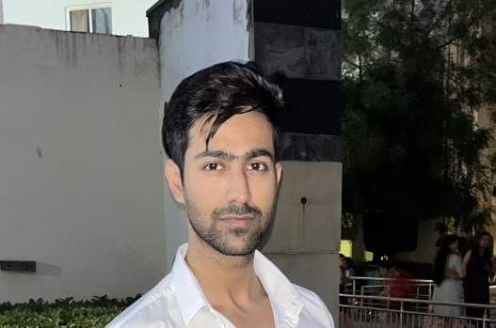

Sagar Virmani
Assistant Manager
sagar.virmani@genpact.com
+91 9810261701
Gurgaon, HR, India
ABOUT ME
EXPERIENCE
As a highly skilled and results-driven data scientist with a strong background in analytics, I am confidently making significant contributions to the organization and to the respective client.
My expertise lies in statistical analysis, Python programming, time-series forecasting, machine learning, NLP and deep learning, and I have a proven track record of using data-driven approaches to solve complex problems and drive business growth.
National Buy-Margin project:
Developed sales forecasting models for suppliers using machine learning techniques like ARIMA, LGBM. …… . Time series forecasting was done with less 1-4 % error difference using each model with varying seasonality, trends and white noise. Feature engineering and statistical analysis was performed, wherever required. Achieved a accuracy of …
Competitive intelligence - COGS discount project:
A COGS discount value of 4.2% was calculated for all Cardinal prescription drugs including branded and over the counter drugs when compared with competitor.
This provided the stakeholders with the correct numbers for changing future sales and marketing strategies corresponding to similar drugs.
SKILLS
MACHINE LEARNING (scikit-learn, NumPy, Pandas, Matplotlib, Seaborn, and PyCaret-for time-series forecasting)
DATA ANALYSIS & EDA (Python and Statistics)
EDUCATION
SQL
2010 - 2014
INDUSTRIES/FUNCTIONS
BACHELOR OF TECHNOLOGY
Maharshi Dayanand University, Rohtak
Pricing analytics
Healthcare
Finance
Web development and design

